Slide 1
Architectural design
Architectural design is concerned about identifying the subsystems of a system and creating a connection between them based on their relationships.
It is mainly concerned about modeling two important components for each subsystem
Modeling process (behaviours)
Modeling data

Slide 2

Repository Model
Subsystems making up a system must exchange information so that they can work together effectively. There are two fundamental ways in which this can be done.
All shared data is held in a central database that can be accessed by all subsystems. A system model based on a shared database is sometimes called a repository model.
Each subsystem maintains its own database. Data is interchanged with other sub-systems by passing messages to them.

Slide 3
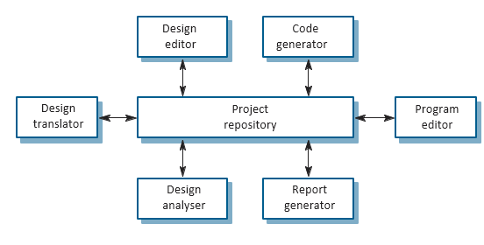
RRepository Model Exampleepository Model Example

Slide 4
Concerns about Repository Model
Good for sharing large amounts of data.
Subsystems that produce data need not be concerned with how that data is used by other subsystems.
All subsystems must agree and compromise on the repository data model. Performance may be affected by this compromise.
It may be difficult to integrate new sub-systems. The data models of the new subsystem must agree on the schema.
Evolution may be difficult as a large volume of information is generated according to an agreed data model. Translating this to a new model will certainly be expensive.
Different subsystems may have different requirements for security, recovery and backup policies. The repository model forces the same policy on all subsystems.
It may be difficult to distribute the repository over a number of machines. Although it is possible to distribute a logically centralized repository, there may be problems with data redundancy and inconsistency

Slide 5
Client-Server Model
The client–server l model is organized as a set of services and associated servers and clients that access and use the services.
A set of servers that offer services to other subsystems. Such as print servers and files servers print servers that offer printing services, file servers that offer file man-agement services and a compile server, which offers programming language compilation services.
A set of clients that call on the services offered by servers. Can be executed concurrently
A network that allows the clients to access these services. Client servers are implemented as distributed systems.

Slide 6
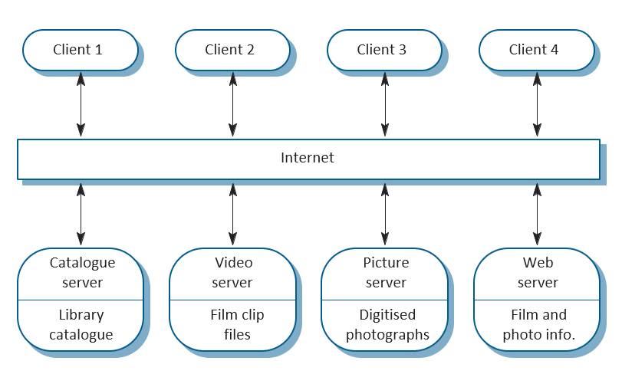
Client-Server Example

Slide 7

Advantages of Client-Servers
The client–server model is a distributed architecture. Effective use can be made of networked systems with many distributed processors.
It is easy to add a new server and integrate it with the rest of the system or to upgrade servers transparently without affecting other parts of the system.
However, there are some issues is related to data formats. There may be no shared data model across servers.
Subsystems may organize their data in different ways.

Slide 8
Layered Model
It is sometimes called an abstract machine model. It organizes a system into layers, each of which provide a set of services.
Each layer can be thought of as an abstract machine whose machine language is defined by the services provided by the layer.
This ‘language’ is used to implement the next level of abstract machine.

Slide 9
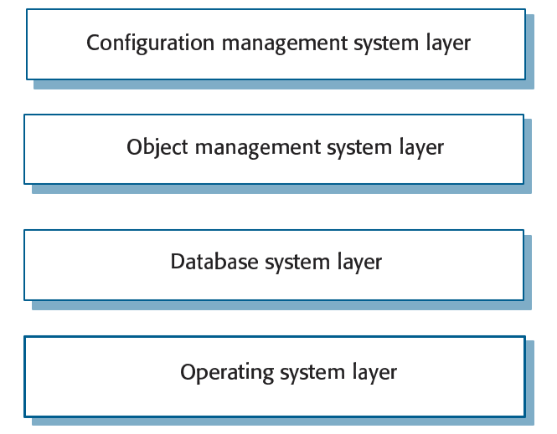
Layered model Example

Slide 10
Characteristics of the Layered Model
It supports the incremental development of systems.
This architecture is also changeable and portable. So long as its interface is unchanged, a layer can be replaced by another, equivalent layer.
When layer interfaces change or new facilities are added to a layer, only the adjacent layer is affected.
A disadvantage of the layered approach is that structuring systems in this way can be difficult.
Inner layers may provide basic facilities, such as file management, that are required at all levels. Services required by a user of the top level may therefore have to ‘punch through’ adjacent layers to get access to services that are provided several levels beneath it.

